Slide 1

Titanic Case Analysis
On April 15, 1912, during her maiden voyage, the Titanic sank after colliding with an iceberg, killing 1502 out of 2224 passengers and crew with 32% survival rate.
One of the reasons that the shipwreck led to such loss of life was that there were not enough lifeboats for the passengers and crew.
Although there was some element of luck involved in surviving the sinking, some groups of people were more likely to survive than others, such as women, children, and the upper-class.

Slide 2
Dataset Description
Categorical: Survived, Sex. Ordinal: Pclass.
Continuous Numerical: Age, Fare.
Ticket is a mix of numeric and alphanumeric data types.
Total samples are 714 or 32.12% of the actual number of passengers on board the Titanic (2,224).
Survived is a categorical feature with 0 or 1 values.
Sex variable as two possible values with 63.45% male (top=male, freq=453/count=714).
Around 41% samples survived representative of the actual survival rate at 40.6%.
Fares varied significantly with few passengers (<1%) paying as high as $512.
Few elderly passengers (<1%) within age range 65-80.
Question
How many people survived?
Does gender have any impact on survival?
Does passenger class have any impact on survival?
Does passenger age have any impact on survival?
Creating
We may also want to create Age Band where age 0-14 is considered as child, age 15-24 as youth, age 25-64 is considered as adult and age 65 and above is considered as old.

Slide 3
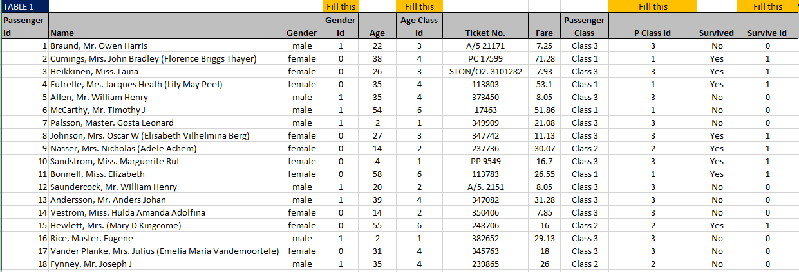
Gender Id, Age Class Id, p Class Id and Survive these values are calculated using vlookup formula.
These values can also be calculated by using ‘nested if’ formula in excel except for Age Class Id as it can throw an error when condition can be neither true nor false. For eg: age 10.5 can neither be in Age Class 1 nor in Age Class 2 by using nested if.

Slide 4
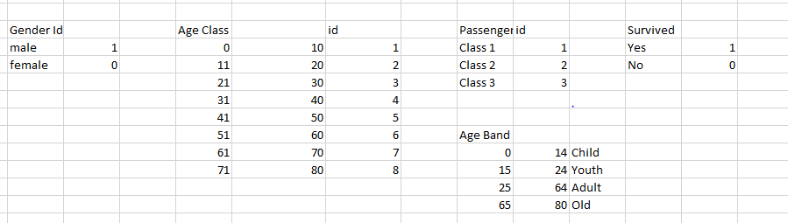
The previous slide values are calculated on these assumptions

Slide 5
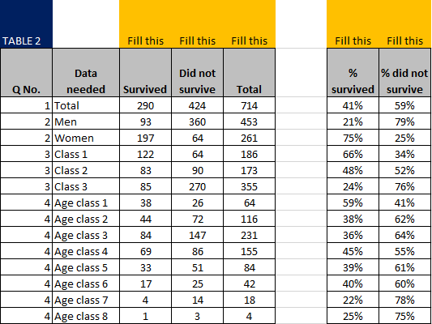
These values are calculate using Pivot Table.

Slide 6
Titanic Survival Analysis

Slide 13
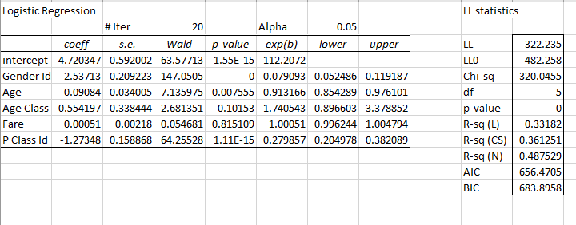
Using Logistic Regression in Titanic Case

Slide 14
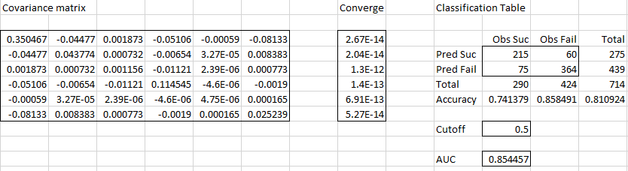

Slide 15
Conclusion
290 passengers survived out of 714 passengers had survival rate of 40.6%.
Gender affect the survival as the count of female survived is more than a male count.(197 females were survived out of 261 females and 93 males were survived out of 360 males).
Passenger Class had an impact on survival as the analysis shows the count of passengers from Class 1 had survived more than other Class.
Even Passenger's age had impact on survival as the highest count is 84 which belongs to Age Class 3 which consist age between 21-30.
As looking the age-band we observe that adult had the highest count on survival(total survived 171) more specifically adult-female (total survived 112).

